Slide 1


Evidence-based Intervention Training for Education
Day 04 - Lesson 02: Progress Monitoring Measures & Rapid Cycle Evaluations

Slide 2



Evaluation Capacity Building for EBI Implementations
Evaluation Methods
Identify Needs
Needs assessment
Data identification, data use
Capacity/readiness assessment
Select an Intervention
Evidence search, appraisal of effectiveness
Evaluate feasibility of EBI and match to needs
Identify core components of EBI
Assess context-fit and consider stakeholder buy-in
Validity concerns: will it work in my setting
Plan for Implementation
Cost assessment
Develop logic model and theory of change
Assess implementation needs and capacity
Identify outcome measures
Implement and adjust
Process evaluation and fidelity to core features
Rapid cycle evaluation
Tracking contextual factors
Examine and Reflect
Assess outcomes
Lessons learned
Sharing (dissemination)
Identify needs
Select an intervention
Plan for implementation
Implement and adjust
Examine and reflect
Cycle of Continuous Improvement
Local Context
Networking
Collaboration
Essential Features of Training
Notes:
When we say an evidence-based practice causes improved learner outcomes, we don’t mean it causes improved learner outcomes for each and every learner. We mean that it improves outcomes for most learners most of the time. Even though it’s not a 100% guaranteed bet for 100% of the targeted population, it’s still approximately 90%. I do think that it’s critically important that we realize that there are what are oftentimes referred to as non-responders or treatment-resisters. Nothing is going to work for everybody. The most evidence-based practice in the world, there’s going to be some students that it doesn’t work for. And these are very often our at-risk learners, our kids with disabilities, our culturally and linguistically diverse students. And so this really points to the importance of taking good progress monitoring data and realizing that, even when we implement an evidence-based practice with fidelity, there’s probably going to be some learners that it doesn’t work for. And that’s okay. It’s still a very good place to start. But then we have to be ready to progress monitor, to look at our implementation fidelity data. And if we’re implementing the practice with fidelity and it’s not producing the outcomes that we desire, we have to think about either moving onto another evidence-based practice, or promising practice, or consider ways that we can make the intervention more intensive or adapted in other ways to make it more effective if it looks like the practice is having some positive effects but just not to the degree that we’d like it to.
Source: https://iris.peabody.vanderbilt.edu/module/ebp_03/cresource/q1/p01/#content

Slide 3
Evaluating the Effectiveness of an EBI
Some things to bear in mind …..
No magical EBI: Regardless of the research supporting an EBI, no EBI will work for all individuals exposed to the intervention, even if implemented “well”
Chicken-and-egg: How do you know if something is working in your local context unless you monitor implementation, track outcomes, and tweak the intervention as needed?
But how do we do that? We need to…
(1) Systematically monitor outcomes
(2) Systematically monitor the fidelity of implementation
(3) Continually examine the relation between outcomes and fidelity of implementation
Notes:
To increase the chance of the EBI working as well as it is designed to, it must be implemented with full fidelity. However, you end up in a chicken-and-egg situation where you cannot know if the program is being implemented with fidelity unless you monitor implementation and test for the program’s impacts.

Slide 4

K–12 Progress Monitoring Measures

Slide 5
Choosing Progress-based Monitoring Measures
Easy to implement
Quick to administer
Cost-effective
Can be administered frequently (e.g., once per week)
Sensitive to change in child or student performance
Used to evaluate progress for physical, cognitive, academic, social-emotional, or behavioral skills or domains
Notes:
Think of these as general outcome measures (GOMS). In other words, formative assessments conducted on a regular basis to assess young child or student performance throughout an entire year’s curriculum. Each test, or probe, assesses skills taught from the beginning of the year to those taught at the end of the year.
Although progress monitoring is an appropriate practice in general to help teachers gauge how well their students are learning, curriculum-based measurement (or CBM) is known as a particular type of progress monitoring that is supported by research. With CBM, a specific set of procedures are used for developing, administering, and scoring progress-monitoring tools, and teachers apply data-based decision rules when looking at the student’s graphed scores. After first determining that CBM tools were reliable and valid and that they were sensitive to changes in students’ academic performance, a series of experimental-contrast studies were conducted to determine whether teachers who used CBM brought about greater growth among their students than teachers who did not use CBM. The evidence indicated that teachers who used CBM—that is, they did not just collect data but used that data for determining when to make instructional modifications in their students’ programs—did, indeed, produce significantly greater growth among their students than teachers who used their own progress monitoring methods. These studies included students in elementary and middle schools who had mild to moderate learning and emotional/behavioral disabilities and addressed different academic domains, such as mathematics and literacy.
Because CBM tools are relatively quick to administer and easy to score, teachers should be able to give them frequently (for example, every week) and can chart how well their students are progressing in the curriculum. Teachers are able to determine how well students are progressing toward a year-end target. More specifically, teachers use the graphed data to determine when their instruction seems to be working as desired or not working. For many students with disabilities, teachers periodically will need to modify or intensify their instruction to bring about better individual growth. Teachers can use CBM graphed data to decide objectively whether these instructional changes are effective and to determine which instructional modification appears to be working the best. Because we know that teachers can bring about better student achievement when they use CBM to inform their instructional decision-making, CBM enjoys many benefits and remains an important evidence-based assessment practice. A number of online versions of CBM are available that enable teachers to administer and to score measures efficiently. Many of these programs also manage student data by storing and displaying student scores and graphs automatically. Some systems even display class graphs for teachers who monitor large groups of students.

Slide 6

Example: K-12 Progress Monitoring Measures
In K–12 education, general outcome measures (GOMs) are commonly referred to as curriculum-based measurements (CBM).
The use of curriculum-based measures is an evidence-based practice for students in grades K–12.
These measures and procedures are well established for the following domains:
Math | Reading | Vocabulary | Writing | Behavior
Lynn Fuchs, PhD Nicholas Hobbs Chair of Special Education and Human Development Vanderbilt University, Nashville, TN | Pamela Stecker, PhD Professor, Special Education Clemson University

Slide 7
Key Considerations when selecting a tool
Is the tool age appropriate?
What are the cost requirements?
What about training? Is it offered? Required? Cost?
How is it administered? Scored automatically or manually?
Will data have to be managed locally?
How technically rigorous is it?
Reliability
Validity
Evidence of ability to detect change
Alternate/parallel forms – different versions of the assessment that are comparable in terms of difficulty?

Slide 10


Breakout Room Activity #01

Slide 11
The Five Pillars of Monitoring Progress
Collect baseline data:
Determine each individual’s current level of performance for the targeted skill (e.g., reading fluency, numeracy). While a single assessment may suffice to establish a baseline, it would be even better to try and conduct multiple assessments over some predefined time period (a week, first two weeks of School, etc) and then use a Median score as the baseline score..
Identify the goal:
Determine the level of performance that you want each individual to reach when the intervention ends. There will usually be some information you can rely on to generate this benchmark. This benchmark is often indicated in the information that accompanies a progress monitoring measure (e.g., word identification fluency: the benchmark is 40 words correct per minute by the end of first grade).
(Modified from the Peabody Institute’s Iris Center)
Notes:
Once you have identified a progress monitoring measure, you are ready to begin monitoring progress.
Here are some steps to consider …

Slide 12
Create a graph: If you are using a commercial progress monitoring measure, the accompanying software will usually generate graphs that show progress. If you have to do this yourself, it can be done in Excel. - Use the horizontal axis to measure the length of the intervention (in weeks, days, months, etc). - Use the vertical axis to measure performance. - Draw a horizontal line to highlight the benchmark. - Draw the Goal Line (the expected trend in performance)
(Modified from the Peabody Institute’s Iris Center)
Notes:
Once you have identified a progress monitoring measure, you are ready to begin monitoring progress.
Here are some steps to consider …

Slide 13
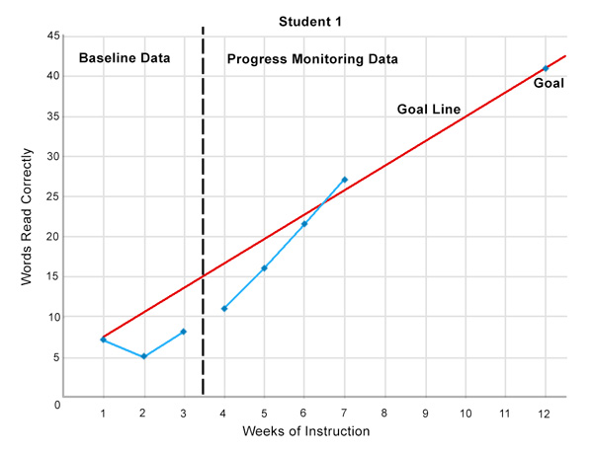
Notes:
The figure below is an example of a student’s progress monitoring graph for reading fluency.
Note that there is a vertical, dashed line separating the baseline data from the progress monitoring data. Also note that there is no line connecting the baseline data points to the progress monitoring data points.

Slide 14

Administer and score probes:
You should administer and score the probes at regular intervals (e.g., weekly, bi-weekly). Again, remember that using multiple probes to evaluate the level of performance at a given point in time is a more robust strategy than using a single probe.
Bryan Cook, PhD Professor, Special Education University of Hawai’i at Mānoa
Graph scores:
Every time a probe is administered, record each individual’s score on the graph and draw a line to connect this score to the individual’s previous score. If using multiple probes per time period, use the Median Score in each time period (ignores unusually high or low scores). Alternately, you can allow your students to graph their own data: Research shows that students who do so are more aware of their performance and view themselves as more responsible for their learning.
(Modified from the Peabody Institute’s Iris Center)
Notes:
Once you have identified a progress monitoring measure, you are ready to begin monitoring progress.
Here are some steps to consider …

Slide 15
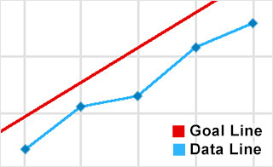
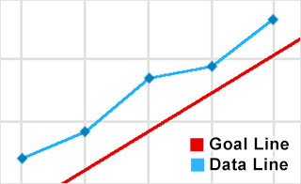
Evaluating Progress
Notes:
To get a reliable estimate of how a child or student is responding to an EBP, you need to implement it for at least three weeks and to score and graph a minimum of six probes. Only then should you evaluate each individual’s performance using the Four Point Method—examining the relationship between the four most-recent data points and the goal line. The figures below illustrate how you can interpret the information from the individual’s graph using the Four Point Method.
If most of the points are on or above the goal line, the child or student is demonstrating improved outcomes.
If most of the points are below the goal line and data indicate that the child or student will not meet the benchmark, performance is not improving.
If an individual’s data are on or above the line, it might be tempting to conclude that the EBP is effective. However, without information about whether the EBP was implemented with fidelity, it is unclear whether:
Something else could be causing the improved performance
An individual could improve even more if the EBP were implemented as intended
Similarly, if an individual’s data are below the line, without fidelity data, you cannot conclude with certainty that the EBP was ineffective. For this reason, it is crucial to collect fidelity data along with the progress monitoring data to determine whether an EBP is effective with your children or students. The next section will cover how to monitor fidelity of implementation.

Slide 16

Effective Data Analysis & Displays
Notes:
Quick look some very good suggestions by Gordon & Conaway on Using Data & Research
Focus for reference will be on Chapter 5
We go back to some stylized examples but also lean here on the individual-level data we have.

Slide 17
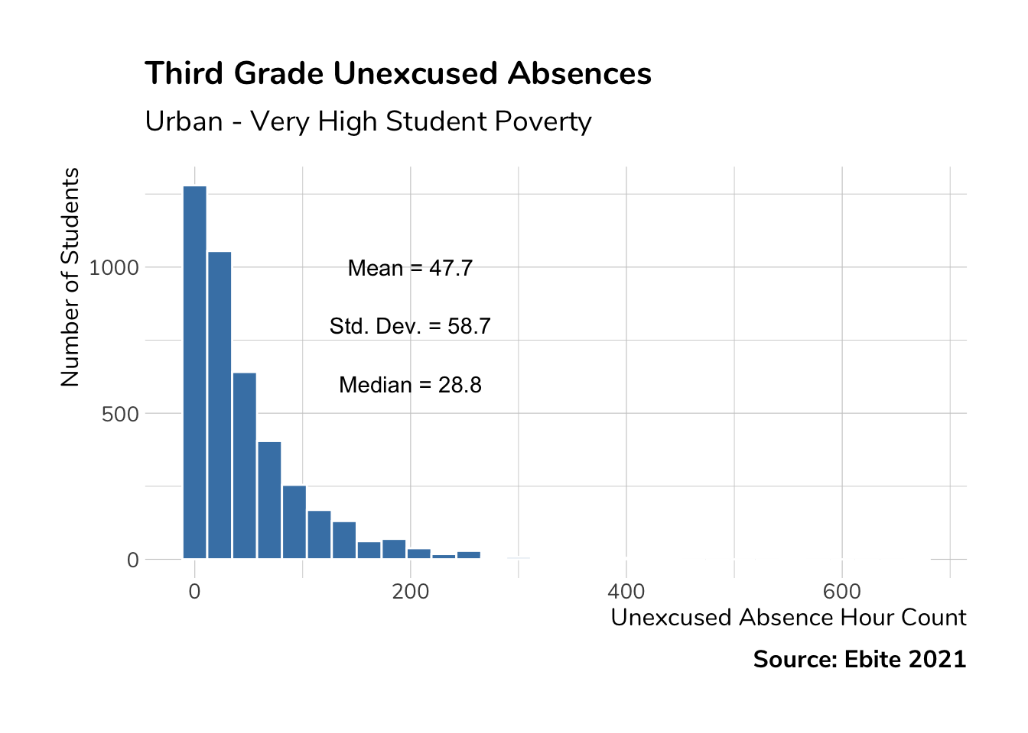
Simplify …
Use goals and benchmarks to set cut-points
Notes:
Notice the skew in Unexcused absences. So Mean and Standard Deviation will be misleading. Better to group absence hours in some meaningful way and look at the distribution of students.

Slide 18
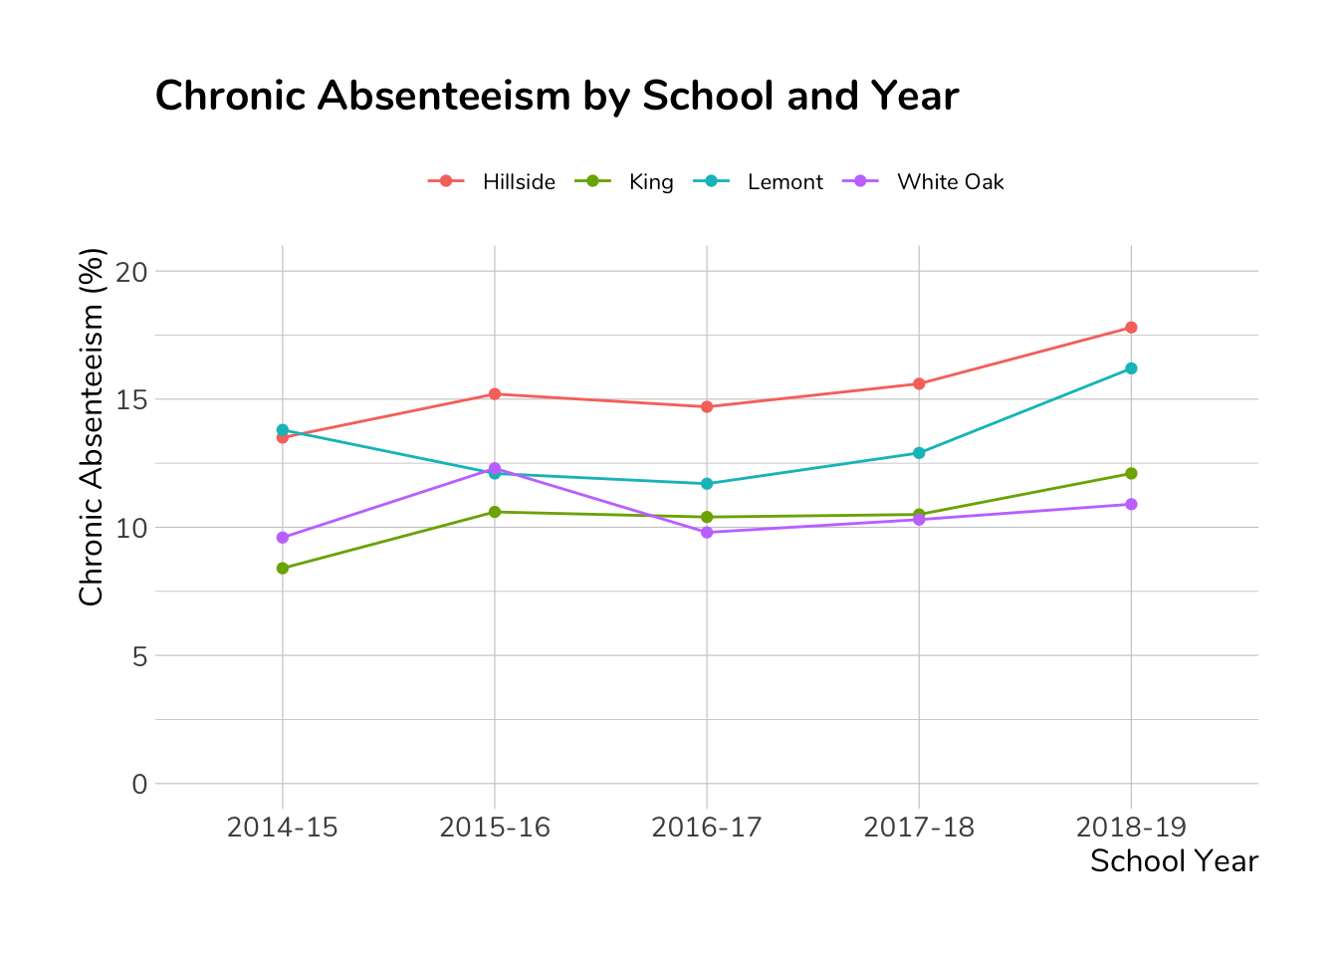
Making Comparisons
Notes:
Compare over time, by school or district, by grade or subject, or by key student demographic

Slide 19
Combining Comparisons

Slide 20
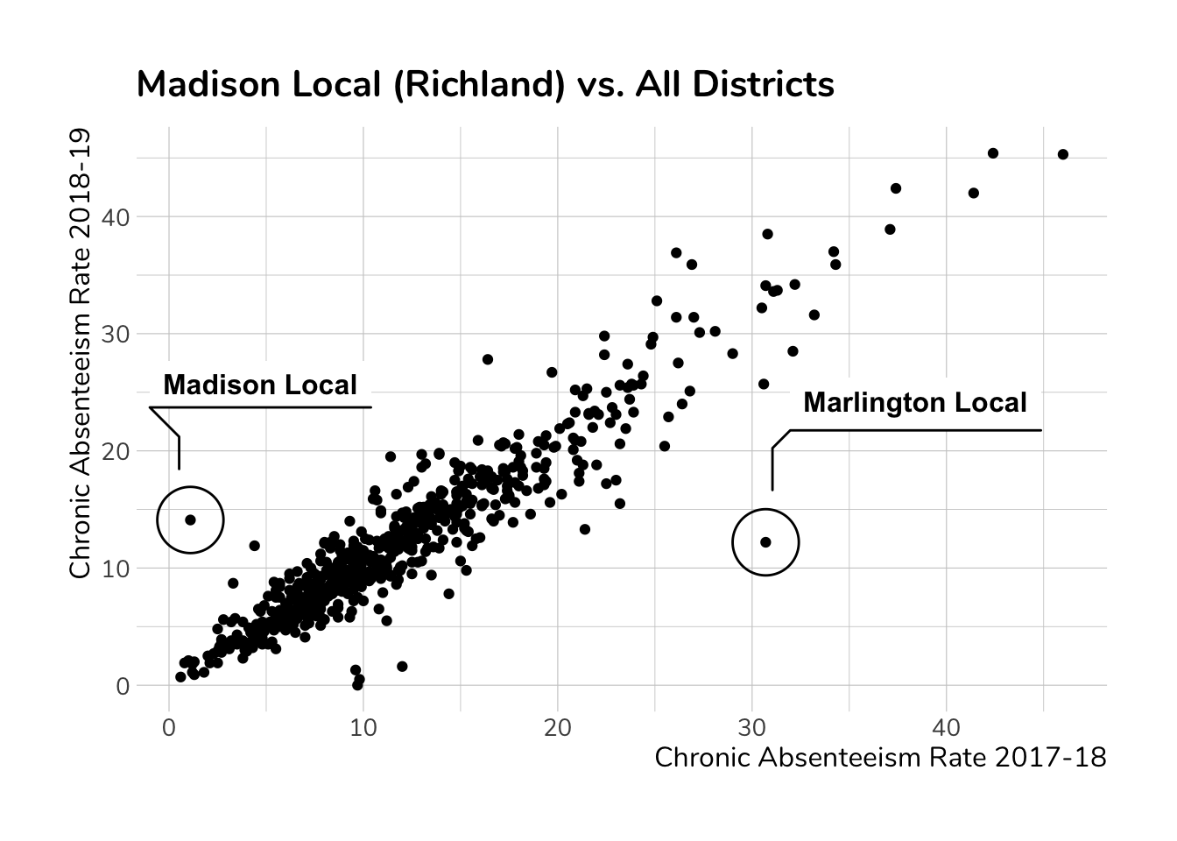
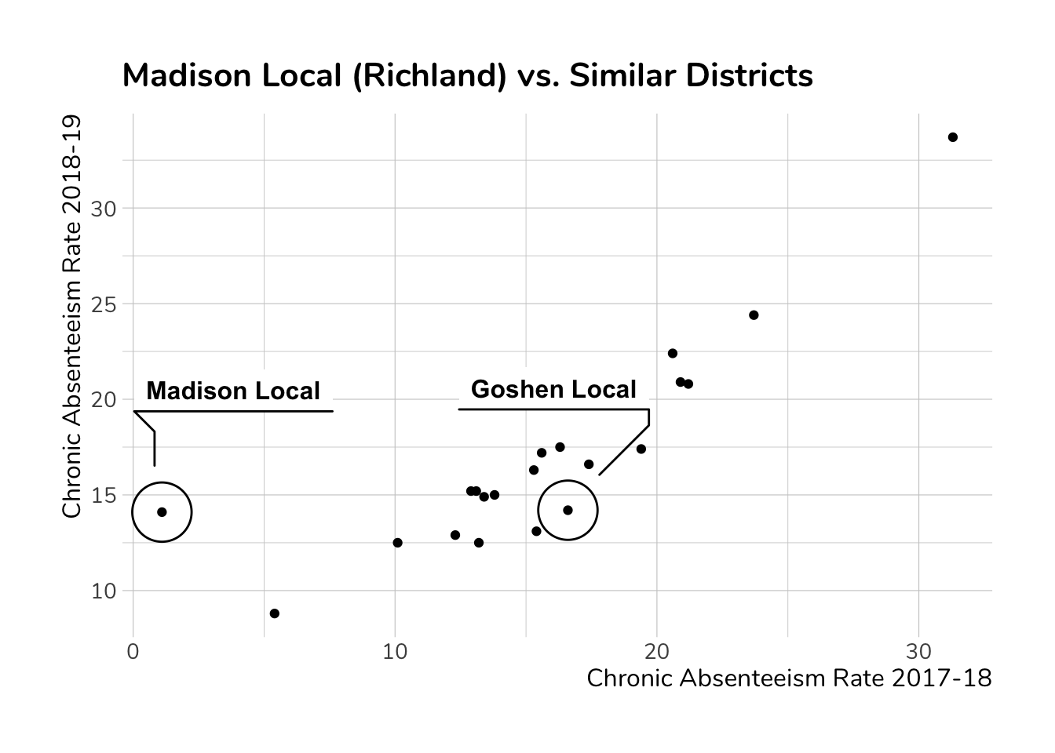
Learn from Unusual Cases

Slide 21

Rapid Cycle Evaluation
Source: Mathematica Policy Research
Notes:
In the optimization phase of development, rapid-cycle experiments can be used to examine which features or versions of a product or program are most effective before implementing and evaluating the final version at scale. Rapid-cycle experiments also can be used to optimize the implementation of a product or program for different types of users.
Rapid-cycle experiments used in the R&D process are shorter (e.g., weeks or months instead of years); test specific aspects of an intervention with the goal of informing further development; and focus on more proximal outcomes, such as initial uptake or compliance with an antismoking regimen, or student engagement with an online learning program.
Alex Resch

Slide 22
Source: Mathematica Policy Research
Notes:
RCE approaches differ in important ways from traditional research approaches. RCE is characterized by rapid testing and analysis, flexibility in design and implementation, a focus on short-term outcomes, and testing specific program/service elements within a program. By contrast, traditional approaches are characterized by longer timelines and more rigid definitions of the intervention and what is being evaluated. The focus is typically on long-term outcomes, and there is usually an assessment of the whole program or service model. However, both approaches can use randomization and experimental or quasi-experimental designs.
RCE approaches are flexible. They incorporate review of interim data throughout the study, which may result in changes to the design, sample, or randomization. While traditional designs would be compromised by such changes, RCE uses methods that ensure the designs remain unbiased and robust despite these changes. Evaluators and program staff can jointly review and interpret interim findings and make modifications to practice and measurement simultaneously. For example, during an interim review of findings, a program discovers that a subgroup is not experiencing positive outcomes through a new service strategy. The program could narrow the target population to a specific subgroup experiencing positive outcomes or increase the number of participants randomized into more effective treatment groups.
Source:

Slide 25
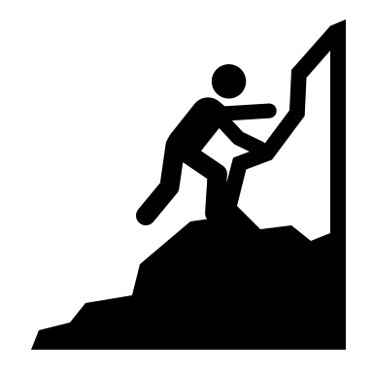


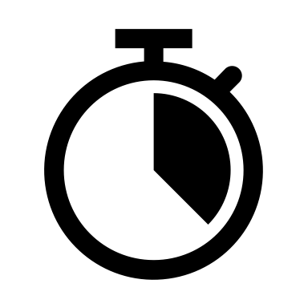
Useful for seeing how a new program might work or how improvements made to an existing program\process are shaping outcomes.
Common methods include randomly created treatment and control groups (experimental) or treatment and control groups formed in a nonrandom way, such as through a matched comparison design (quasi-experimental).
To ensure timely and low-cost analysis, rapid-cycle evaluation relies primarily on existing program data or integrated administrative data systems that span multiple programs. It is also important that the available data are highly accurate, valid, and reliable measures of the expected outcomes.
In order to achieve both (i) a rapid analysis of the impact of a change, as well as (ii) cycles of testing and refinement, the relevant results should be observable in the short term. The length of time necessary to observe a given result will vary depending upon the context, but in most cases should not exceed one year.
Notes:
Source: https://www.mathematica-mpr.com/-/media/publications/pdfs/education/2016/if_rce.pdf

Slide 26
An Example based on a real study
Program Goal: Increase home visitors’ rate of appropriate referrals to mental health services for mothers screening positive for depression.
Intervention: Provide home visitors with trainings, written guidance and access to mental health consultants so they make fewer mistakes on the depression screener.
Measurement Problem: Referral data collected too infrequently to be used formatively.
Measurement Solution: Used a series of questions to measure home visitors’ self-efficacy in decision-making to meet identified needs.
The Evaluation Cycle:
Every home visit required the visitor to complete the measurement tool
Every two weeks the self-efficacy data would be analyzed to look for increases
Based on what was being seen every two weeks, trainings, guidance provided, and mental health consultants’ services were adjusted
Adjustments stopped once home visitors’ degree of self-efficacy in decision-making was high enough.
Impact: In 6 months, the rate of appropriate referrals increased by 20%

Slide 27
Another Example
Background: Two home visiting programs reported a high dropout rate among two-parent rural families. Home visitors reported that the curriculum was not resonating equally within those families. They suggested delivering all sessions to primary caregivers and delivering only certain sessions to both caregivers.
Research question: What engagement strategies are most effective in increasing participation for two-parent rural families enrolled in a home visiting program?
Study description: Engagement strategies are tested with two-parent rural families to determine if they increase program engagement and completion in 3 years.
Study using RCE.
Parents initially receive a standard engagement protocol to establish a baseline.
They are then randomized into two groups: one receives all sessions, and the other receives selected sessions.
Data are collected on the number of visits completed, home visitor perception of engagement, and curriculum components.
For both groups, the program reviews the data weekly, makes modifications to components that indicate poor engagement, and adjusts which parents receive which sessions. It analyzes the effect on outcomes at the conclusion of the study.

Slide 29
Breakout Room Activity #02
Any downsides? …
While RCE are low-cost, require smaller samples, help finetune the intervention to local contexts for continuous improvement …
They do add another layer of data collection and evaluation, and short-term impacts may not guarantee long-term outcomes

Slide 30

Q & A
Contact us ebiteohio@gmail.com

